Slide 1

Home Loan Prediction ML Project 1st Sem
Team Name: Swaroop-Subham
Members:
Subham Basu Roy Chowdhury – MT2022118
Swaroop Dixit - MT2022121

Slide 2
Problem Description:
Many people struggle to get loans due to insufficient or non-existent credit histories. And, unfortunately, this population is often taken advantage of by untrustworthy lenders.
Home Credit strives to broaden financial inclusion for the unbanked population by providing a positive and safe borrowing experience. In order to make sure this underserved population has a positive loan experience, Home Credit makes use of a variety of alternative data--including telco and transactional information--to predict their clients' repayment abilities.

Slide 3

CHECKPOINT 3 FINAL SUBMISSION

Slide 4
Flow of the Solution for Training Data:
Data Visualization & Information
Preprocessing
Train Test Split the Training Data
Feature Engineering
Feature Selection
Apply various Models to get accuracy
Hyperparameter tuning
Making predictions with the best model on test data

Slide 5
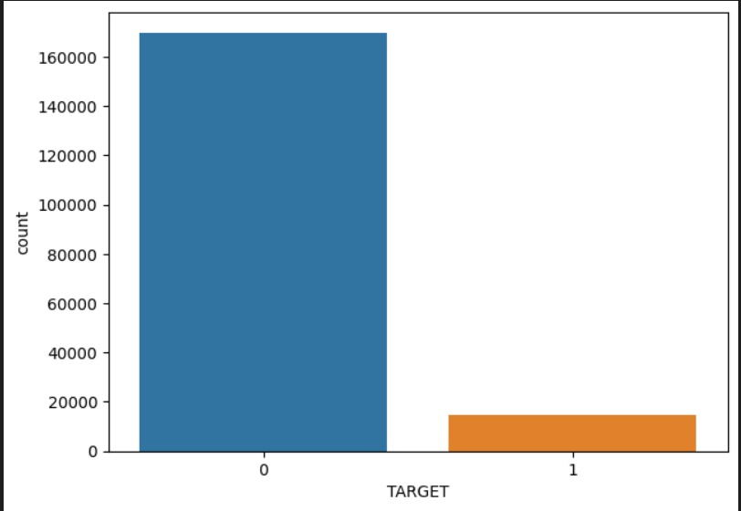
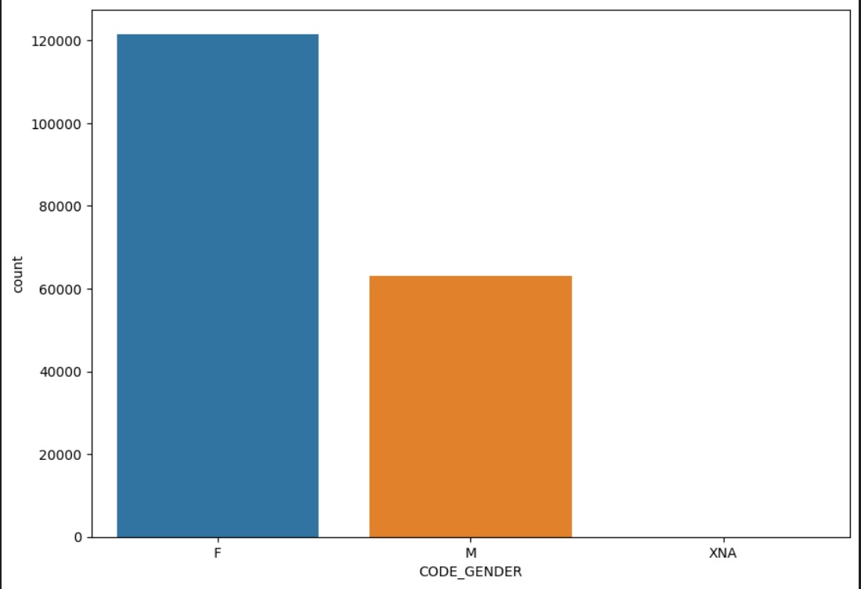
Data Visualization
How many people defaulted?
Who is the highest borrower based on gender?

Slide 6
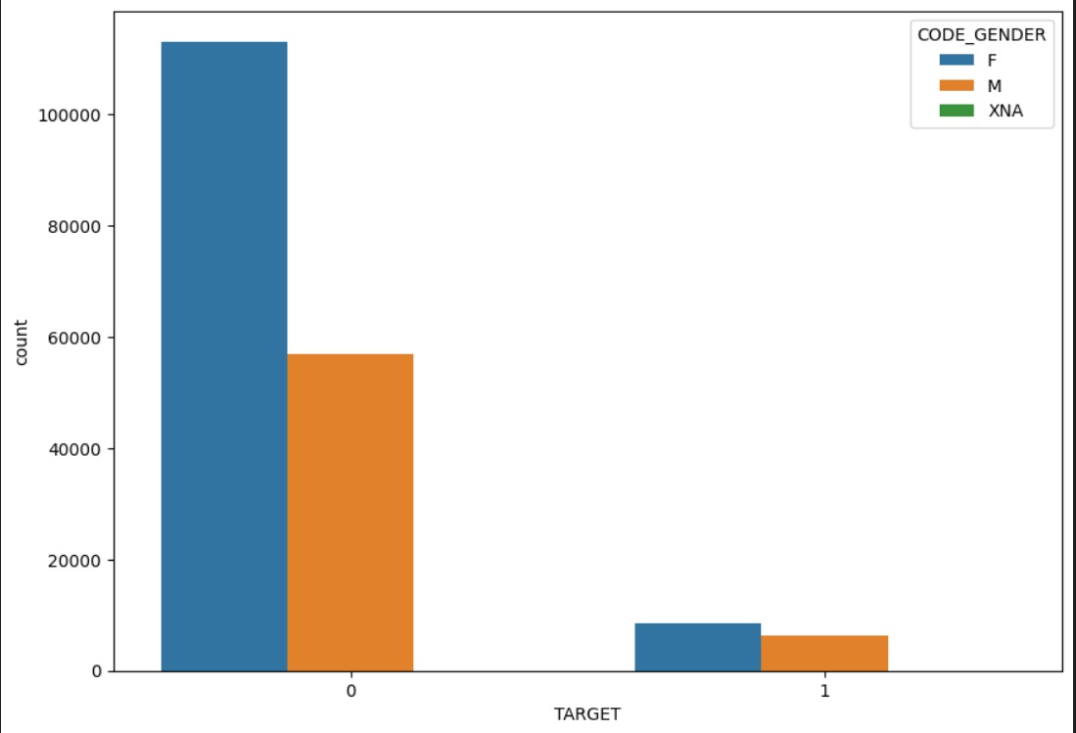
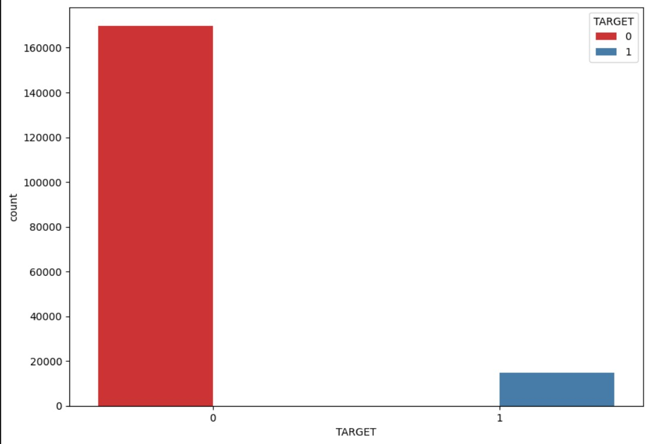
Data Visualization Contd..
Which Gender has more difficulty in repayment?
How many people return Loan on time?

Slide 7
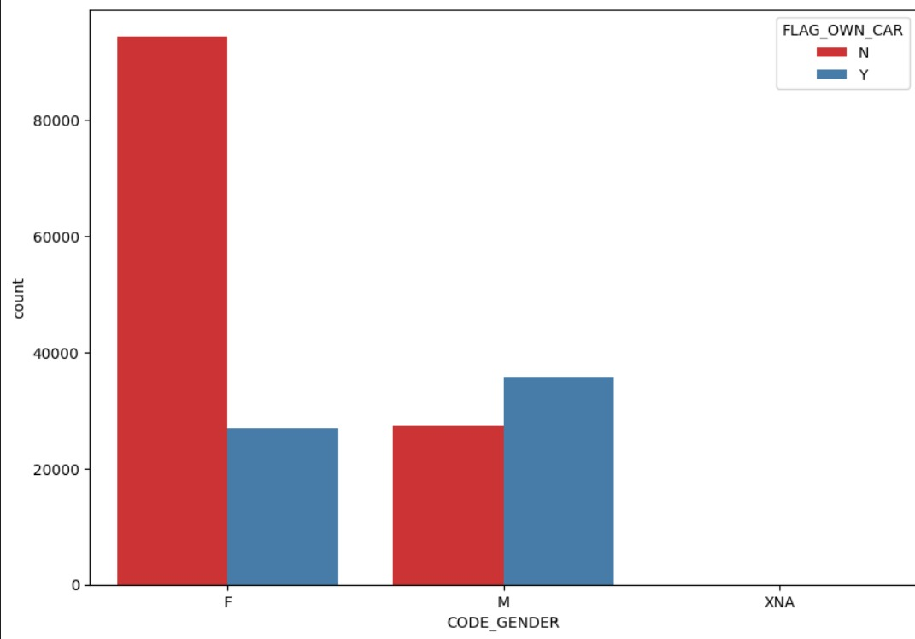
Data Visualization Contd..
Who owns most number of cars by Gender?
Observation:
1. The given data set is highly imbalanced
2. The Gender column contains some absurd values like XNA which has no significant meaning.
3. These issues have been handled in later phases of the project.

Slide 8
Preprocessing
Find if the dataset have NULL values
Remove the columns that have NULL values > 60%
Handle the NULLs in remaining columns.
For the categorical data we replaced the Nulls with mode
For non-categorical data we replaced the Nulls with median.(Not used Mean as it has outliers present in it)
Found some absurd values in some columns we replaced with Nulls.

Slide 9
Preprocessing Contd..
Checked for Duplicate rows.
Found some columns that had -ve values we changed it to +ve values by taking the abs of the entire column.
Separate the entire training dataset into x and y, where x= input features and y= output features.

Slide 10
Feature Engineering
Used Boxplot to check for Outliers. Surprisingly we found a huge amount of outliers in our dataset.
We then used InterQuartile Range (IQR) method to cap the outliers. [Capping refers that we did not remove the data instead we changed the outliers to fit in normal range.]
We used Label-Encoding to change categorical data to numerical data.
We used SMOTE technique to handle the huge imbalance present in the given data.
We used sklearn.train_test split to split the entire training data into training set and testing set with a ratio of 0.7 and a random state of 30. [random state is used to reproduce the result]
We also tried to encode the categorical data with one-hot encoding but that did not give performance with the models that we used later.

Slide 11
Feature Selection
We used df.corr() to find the correlation of the input set with the output set.
We dropped the features with low correlation with the target variable.
We used RandomForestClassifier followed by Select From Model library function to get the best features or in other words we did dimensionality reduction.
Finally we used sklean Standard Scalar to scale the training data.

Slide 12
Applying Models...
Logistic regression
K Nearest Neighbours
Support Vector Machines
XGboost Classifier
Decision Trees Classifier
Random Forest Classifier
Naïve Bayes – Gaussian & Bernoulli
LGM Classifier

Slide 13
Models Contd..
Metrics used to check the accuracy were:
Accuracy_score
F1_score
Roc_Auc Score
Confusion Matrix
Classification Report

Slide 14
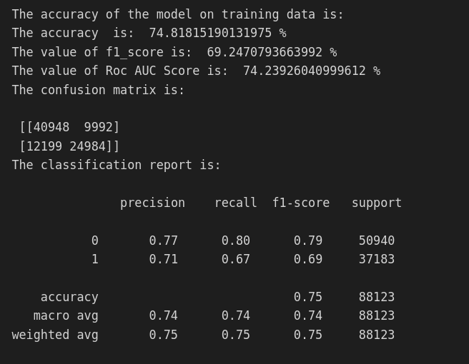
Logistic Regression

Slide 15
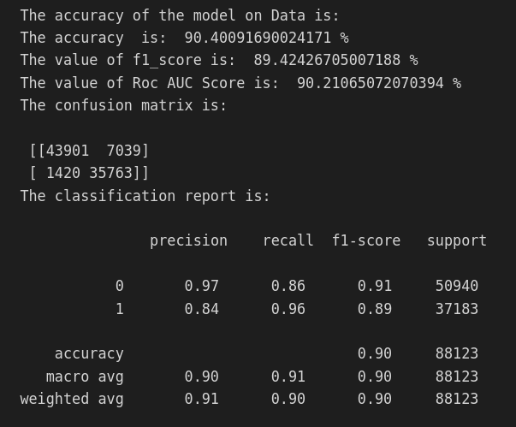
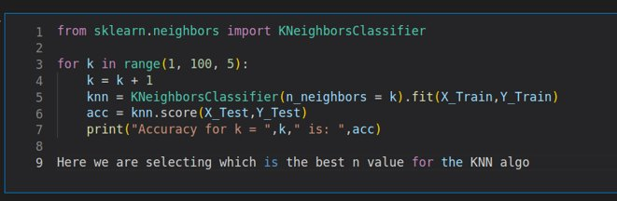
K Nearest Neighbours
Use the best K to get accuracy
Find the best value of K suited for our data..

Slide 16
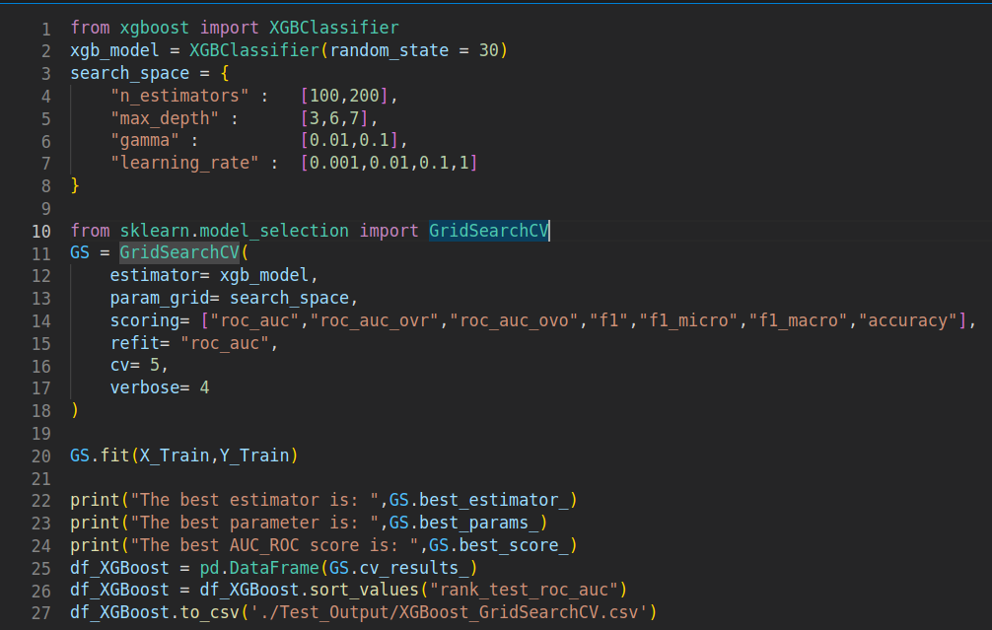
XG BOOST Hyperparameter Tuning

Slide 17
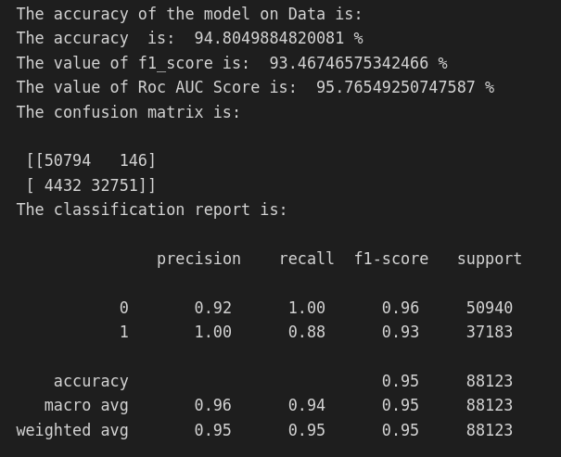
XG Boost Model

Slide 18
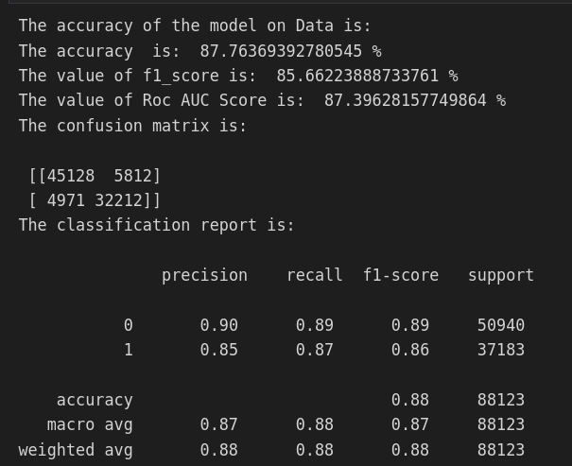
Decision Trees

Slide 19

Random Forest

Slide 20
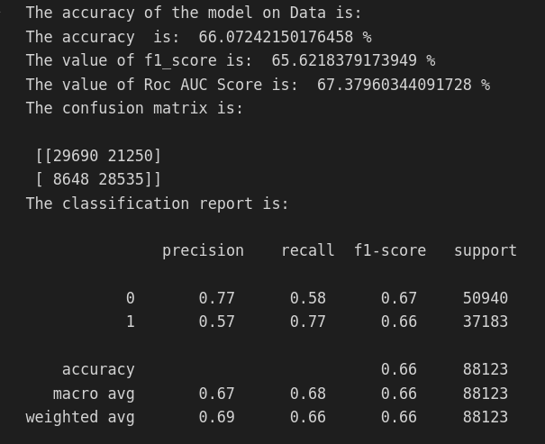
Gaussian Naïve Bayes

Slide 21
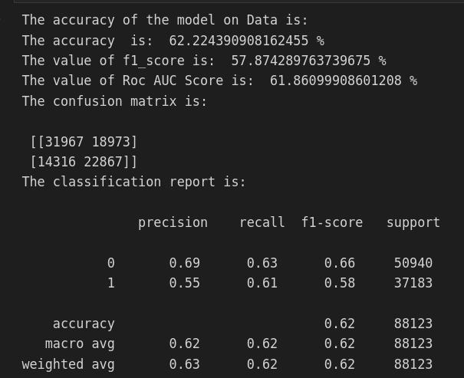
Bernoulli Naïve Bayes

Slide 22
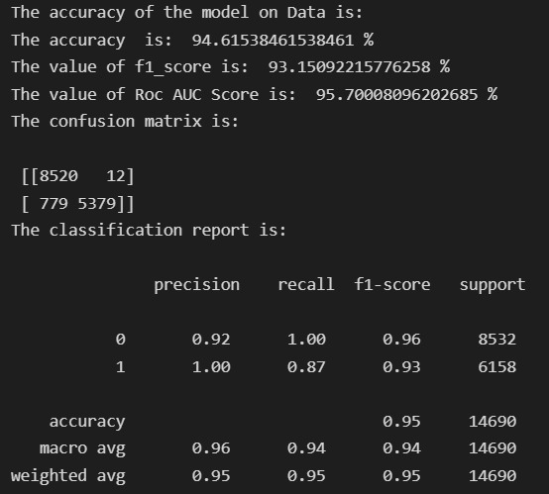
LGM Classifier

Slide 23
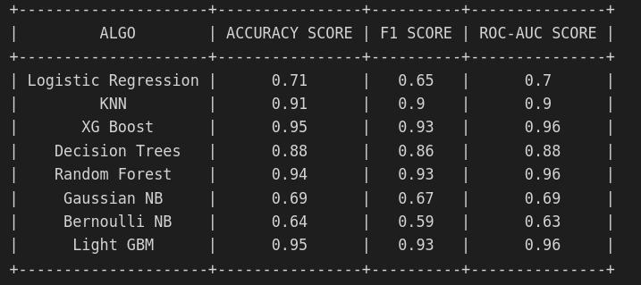
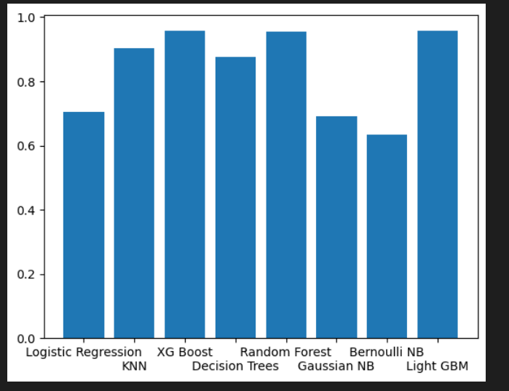
Comparison of Models

Slide 24
Flow of Solution for the Test Data
Load the test Data Set
Keep the same columns that are present after preprocessing the training data.
Handle the nulls, absurd values, outliers in the same way as in train data.
Label Encode the categorical columns
Apply Standard Scaling on the entire test data.

Slide 25
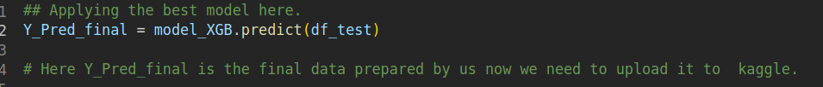
Apply best Model as per training
Since we got the best output from the XGBoost model, so we decided to go ahead with XGBoost to get the predictions for the test data.

Slide 26
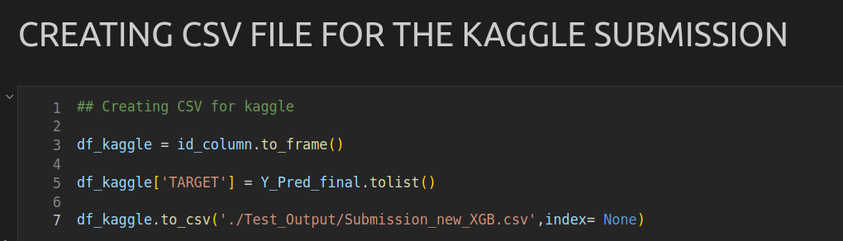
CSV file for Kaggle Submission

Slide 27

Thank You

